Slide 1

Applied Cryptography Pollard $p−1$ algorithm, Pollard Rho algorithm
Liangfeng Zhang
School of Information Science and Technology
ShanghaiTech University

Slide 2
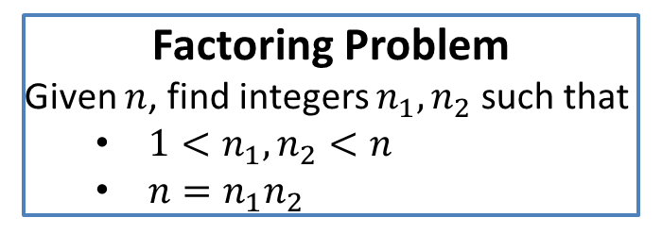
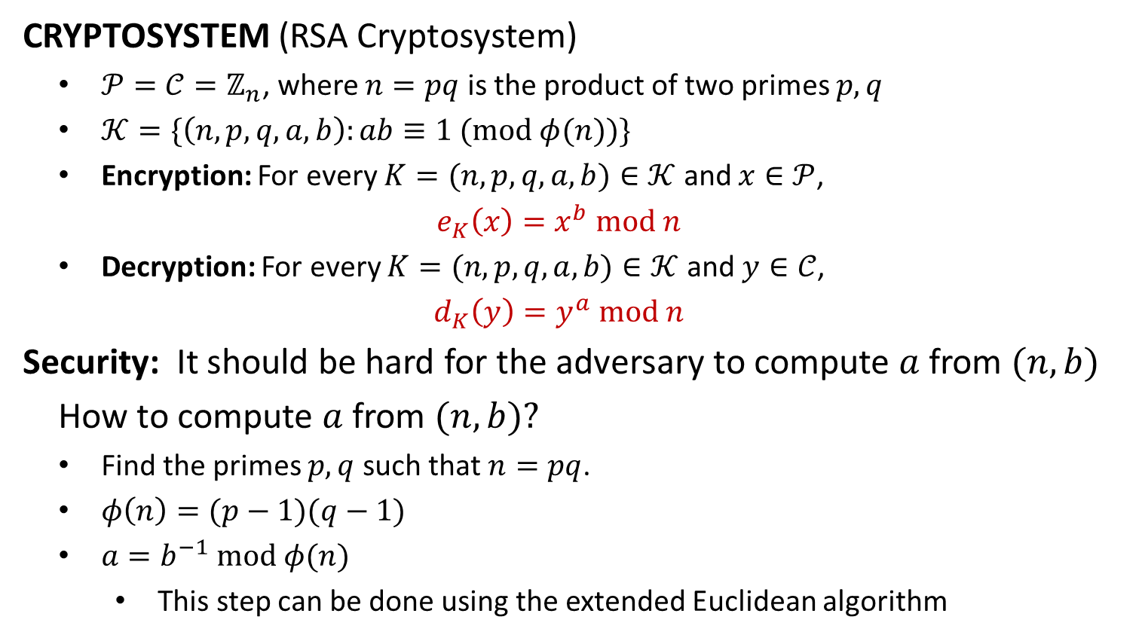
The RSA Cryptosystem
CRYPTOSYSTEM (RSA Cryptosystem)
$𝒫=𝒞=ℤ_{n}$, where $n=pq$ is the product of two primes $p,q$
$𝒦=\{\left(n,p,q,a,b\right):ab≡1 (mod φ(n))\}$
Encryption: For every $K=(n,p,q,a,b)∈𝒦$ and $x∈𝒫$,
$$e_{K}\left(x\right)=x^{b} mod n$$
Decryption: For every $K=(n,p,q,a,b)∈𝒦$ and $y∈𝒞$,
$$d_{K}\left(y\right)=y^{a} mod n$$
Security: It should be hard for the adversary to compute $a$ from $(n,b)$
How to compute $a$ from $(n,b)$?
Find the primes $p,q$ such that $n=pq$.
$φ\left(n\right)=(p−1)(q−1)$
$a=b^{−1} mod φ(n)$
This step can be done using the extended Euclidean algorithm
Factoring Problem
Given $n$, find integers $n_{1}, n_{2}$ such that
$1<n_{1},n_{2}<n$
$n=n_{1}n_{2}$

Slide 4
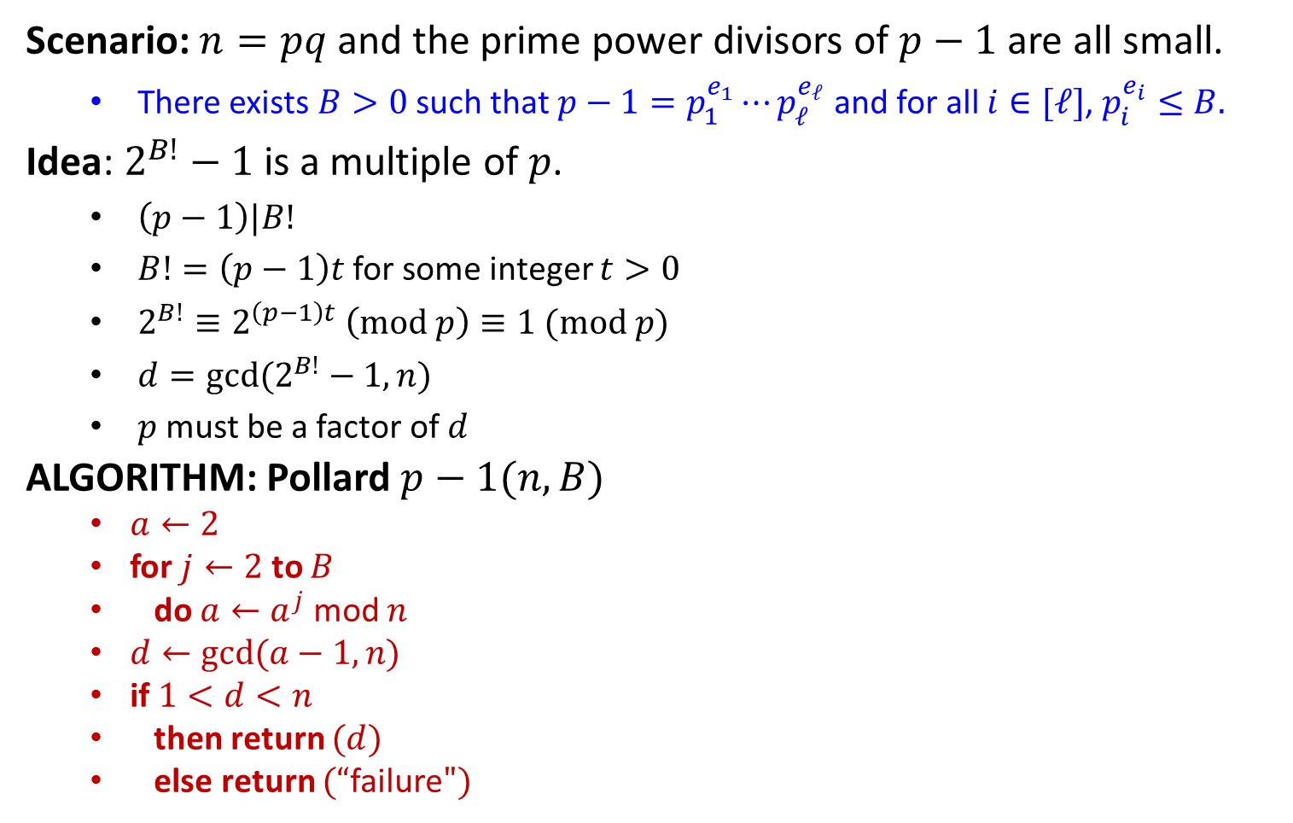


Pollard $p−1$ Algorithm
Scenario: $n=pq$ and the prime power divisors of $p−1$ are all small.
There exists $B>0$ such that $p−1=p_{1}^{e_{1}}⋯p_{ℓ}^{e_{ℓ}}$ and for all $i∈[ℓ]$, $p_{i}^{e_{i}}≤B.$
Idea: $2^{B!}−1$ is a multiple of $p$.
$\left(p−1\right)|B!$
$B!=\left(p−1\right)t$ for some integer $t>0$
$2^{B!}≡2^{\left(p−1\right)t} \left(mod p\right)≡1 (mod p)$
$d=gcd⁡(2^{B!}−1,n)$
$p$ must be a factor of $d$
ALGORITHM: Pollard $p−1(n,B)$
$a←2$
for $j←2$ to $B$
do $a←a^{j}$ mod $n$
$d←gcd(a−1,n)$
if $1<d<n$
then return $(d)$
else return $(“$failure$")$
EXAMPLE
$n=15770708441$
$B= 180$
$a=2^{B!} (mod n)$
$=$ $11620221425 (mod n)$
$d=\gcd\left(a−1,n\right)$
$=$ $135979$
$n = 135979 × 115979$
$p−1=2×3×131×173$

Slide 5
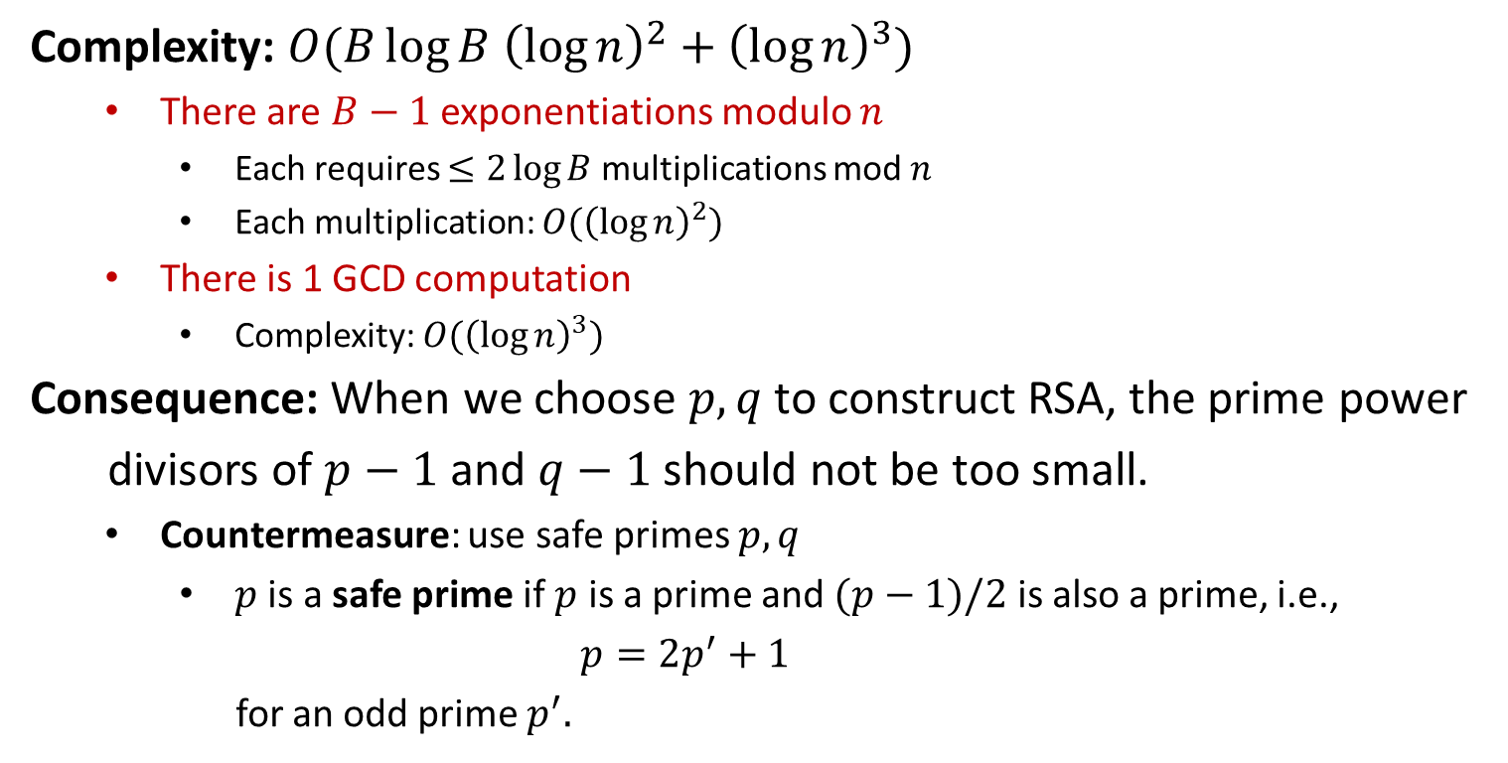
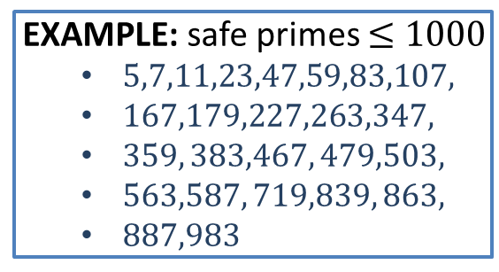
Pollard $p−1$ Algorithm
Complexity: $O(B\log{B {\left(\log{n}\right)}^{2}+{\left(\log{n}\right)}^{3}})$
There are $B−1$ exponentiations modulo $n$
Each requires $≤2\log{B}$ multiplications mod $n$
Each multiplication: $O({\left(\log{n}\right)}^{2})$
There is 1 GCD computation
Complexity: $O({\left(\log{n}\right)}^{3})$
Consequence: When we choose $p,q$ to construct RSA, the prime power
divisors of $p−1$ and $q−1$ should not be too small.
Countermeasure: use safe primes $p,q$
$p$ is a safe prime if $p$ is a prime and $(p−1)/2$ is also a prime, i.e.,
$$p=2p^{′}+1$$
for an odd prime $p^{′}.$
EXAMPLE: safe primes $≤1000$
$5,7,11,23,47,59,83,107,$
$167,179,227,263,347,$
$359, 383,467, 479,503,$
$563,587, 719,839, 863,$
$887,983$

Slide 7
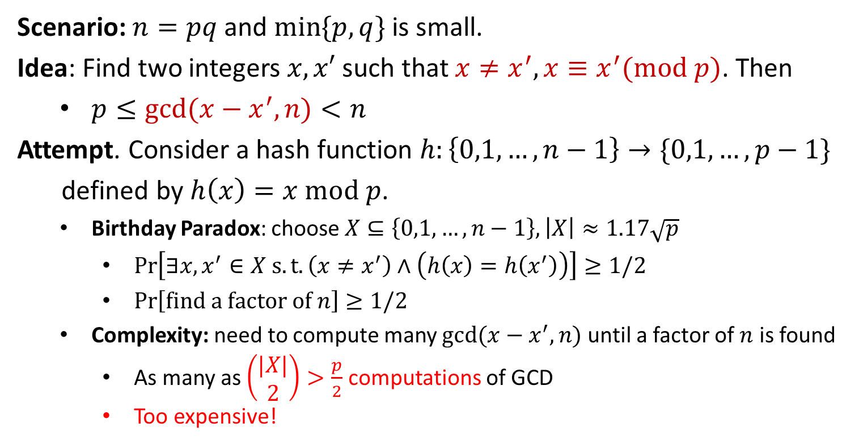
Pollard Rho Algorithm
Scenario: $n=pq$ and $\min{\{p,q\}}$ is small.
Idea: Find two integers $x,x′$ such that $x≠x^{′}, x≡x^{′}(mod p)$. Then
$p≤\gcd{(x−x^{′},n)}<n$
Attempt. Consider a hash function $h:\left\{0,1,…,n−1\right\}→\{0,1,…,p−1\}$
defined by $h\left(x\right)=x mod p$.
Birthday Paradox: choose $X⊆\left\{0,1,…,n−1\right\}, \left|X\right|≈1.17\sqrt{p}$
$\operatorname{Pr}\left[∃x,x^{′}∈X s.t. \left(x≠x^{′}\right)∧\left(h\left(x\right)=h\left(x^{′}\right)\right)\right]≥1/2$
$\operatorname{Pr}\left[find a factor of n\right]≥1/2$
Complexity: need to compute many $gcd⁡(x−x^{′},n)$ until a factor of $n$ is found
As many as $\left(\begin{aligned}|X| \\ 2\end{aligned}\right)>\frac{p}{2}$ computations of GCD
Too expensive!

Slide 8

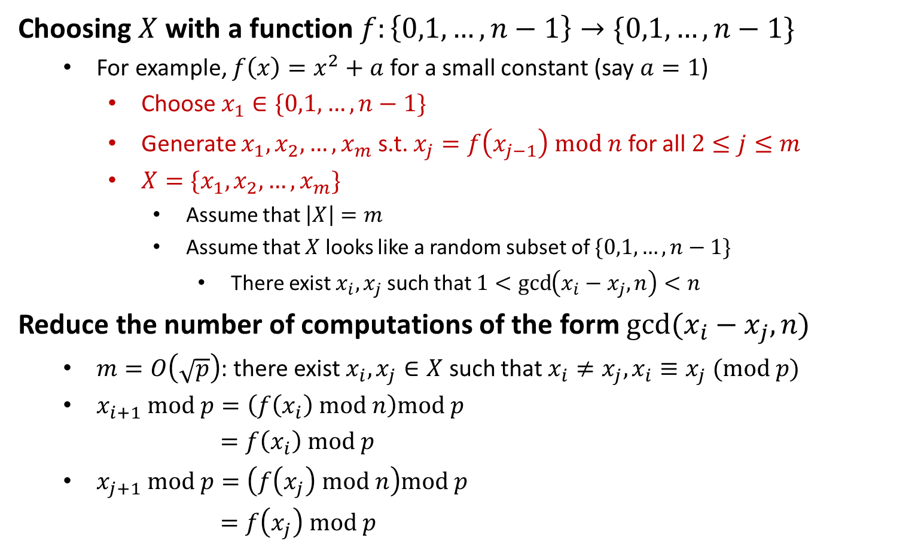



Pollard Rho Algorithm
Choosing $X$ with a function $f:\left\{0,1,…,n−1\right\}→\{0,1,…,n−1\}$
For example, $f\left(x\right)=x^{2}+a$ for a small constant (say $a=1$)
Choose $x_{1}∈\{0,1,…,n−1\}$
Generate $x_{1},x_{2},…,x_{m}$ s.t. $x_{j}=f\left(x_{j−1}\right) mod n$ for all $2≤j≤m$
$X=\{x_{1},x_{2},…,x_{m}\}$
Assume that $\left|X\right|=m$
Assume that $X$ looks like a random subset of $\{0,1,…,n−1\}$
There exist $x_{i},x_{j}$ such that $1<\gcd\left(x_{i}−x_{j},n\right)<n$
Reduce the number of computations of the form $gcd(x_{i}−x_{j},n)$
$m=O\left(\sqrt{p}\right)$: there exist $x_{i},x_{j}∈X$ such that $x_{i}≠x_{j}, x_{i}≡x_{j} (mod p)$
$x_{i+1} mod p=\left(f\left(x_{i}\right) mod n\right)mod p$
$=f\left(x_{i}\right) mod p$
$x_{j+1} mod p=\left(f\left(x_{j}\right) mod n\right)mod p$
$=f\left(x_{j}\right) mod p$
$$x_{i+1} mod p=x_{j+1} mod p$$
$$x_{i+2} mod p=x_{j+2} mod p$$
$$⋮$$
$$x_{i+δ} mod p=x_{j+δ} mod p$$

Slide 9


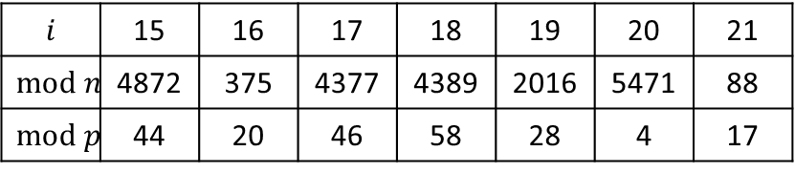



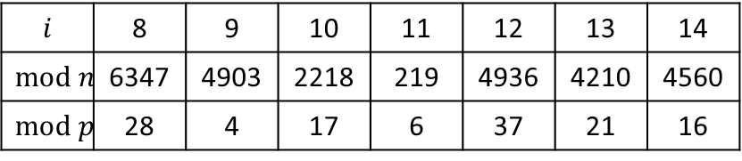

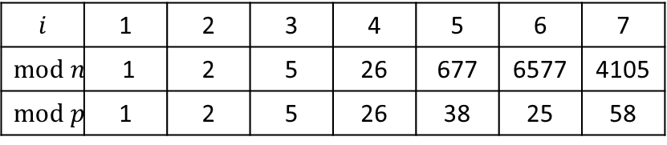

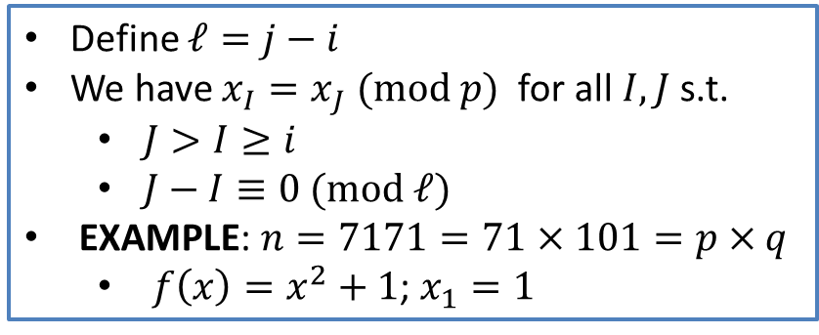






Pollard Rho Algorithm
Define $ℓ=j−i$
We have $x_{I}=x_{J} (mod p)$ for all $I,J$ s.t.
$J>I≥i$
$J−I≡0 (mod ℓ)$
EXAMPLE: $n=7171=71×101=p×q$
$f\left(x\right)=x^{2}+1$; $x_{1}=1$
$$x_{j+2}$$
$$x_{j+1}$$
$$x_{i+1}$$
$$x_{i+2}$$
$$x_{j}$$
$$⋮$$
$$x_{i}$$
$$x_{j−1}$$
$$x_{i−1}$$
$$i$$ | 1 | 2 | 3 | 4 | 5 | 6 | 7
$$mod n$$ | 1 | 2 | 5 | 26 | 677 | 6577 | 4105
$$mod p$$ | 1 | 2 | 5 | 26 | 38 | 25 | 58
$$⋯$$
$$⋮$$
$$x_{2}$$
$$i$$ | 8 | 9 | 10 | 11 | 12 | 13 | 14
$$mod n$$ | 6347 | 4903 | 2218 | 219 | 4936 | 4210 | 4560
$$mod p$$ | 28 | 4 | 17 | 6 | 37 | 21 | 16
$$x_{1}$$
$$i$$ | 15 | 16 | 17 | 18 | 19 | 20 | 21
$$mod n$$ | 4872 | 375 | 4377 | 4389 | 2016 | 5471 | 88
$$mod p$$ | 44 | 20 | 46 | 58 | 28 | 4 | 17

Slide 10
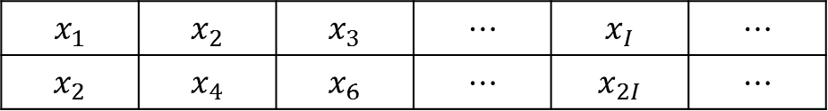
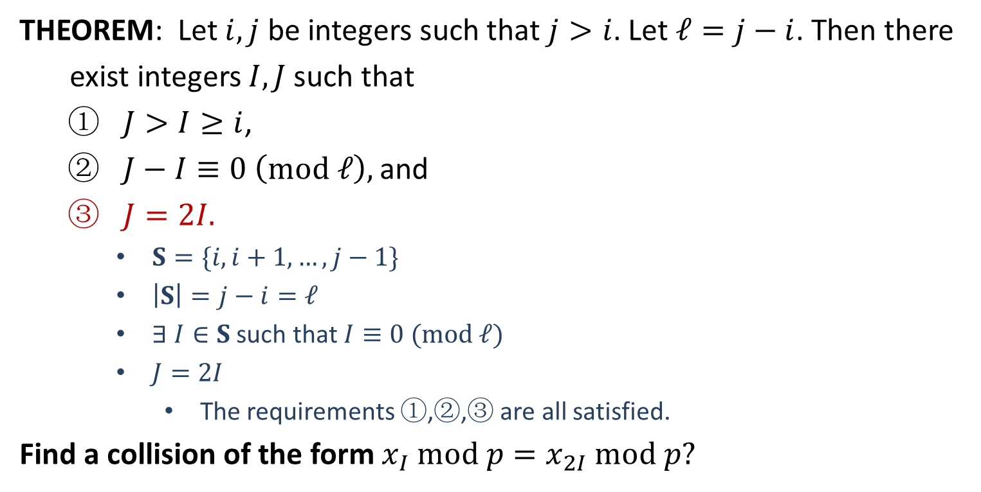
Pollard Rho Algorithm
THEOREM: Let $i,j$ be integers such that $j>i$. Let $ℓ=j−i$. Then there
exist integers $I,J$ such that
$J>I≥i$,
$J−I≡0 \left(mod ℓ\right),$ and
$J=2I.$
$S=\{i,i+1,…,j−1\}$
$\left|S\right|=j−i=ℓ$
$∃ I∈S$ such that $I≡0 (mod ℓ)$
$J=2I$
The requirements ①,②,③ are all satisfied.
Find a collision of the form $x_{I} mod p=x_{2I} mod p?$
$$x_{1}$$ | $$x_{2}$$ | $$x_{3}$$ | $$⋯$$ | $$x_{I}$$ | $$⋯$$
$$x_{2}$$ | $$x_{4}$$ | $$x_{6}$$ | $$⋯$$ | $$x_{2I}$$ | $$⋯$$

Slide 11
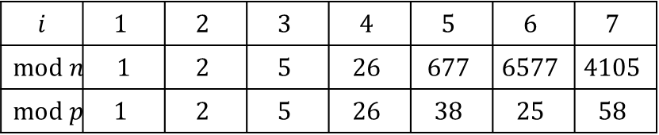

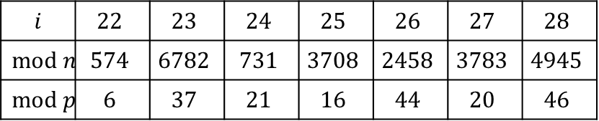
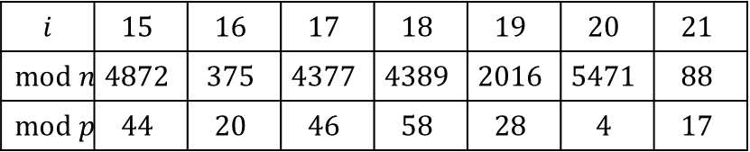
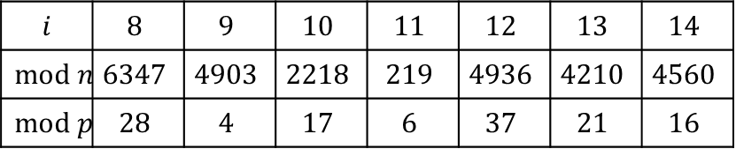
Pollard Rho Algorithm
ALGORITHM: Pollard Rho Factoring Algorithm$(n,x_{1})$
external: $f$
$x←x_{1}$
$x′←f(x)$ mod $n$
$p←gcd(x−x′,n)$
while $p=1$
do$\left\{\begin{aligned} \\ x←f\left(x\right) mod n \\ x′←f\left(x′\right) mod n \\ x′←f\left(x′\right) mod n \\ p←gcd(x−x′,n)\end{aligned}\right.$
if $p=n$
then return $(“$failure$")$
else return $(p)$
ANALYSIS: $p<\sqrt{n}$
$O\left(\sqrt{p}\right)=O(n^{1/4})$ computations
$n=pq$ should be chosen such that $\min{\{p,q\}}$ is large enough!
$$i$$ | $$1$$ | $$2$$ | $$3$$ | $$4$$ | $$5$$ | $$6$$ | $$7$$
$$mod n$$ | $$1$$ | $$2$$ | $$5$$ | $$26$$ | $$677$$ | $$6577$$ | $$4105$$
$$mod p$$ | $$1$$ | $$2$$ | $$5$$ | $$26$$ | $$38$$ | $$25$$ | $$58$$
$$i$$ | $$8$$ | $$9$$ | $$10$$ | $$11$$ | $$12$$ | $$13$$ | $$14$$
$$mod n$$ | $$6347$$ | $$4903$$ | $$2218$$ | $$219$$ | $$4936$$ | $$4210$$ | $$4560$$
$$mod p$$ | $$28$$ | $$4$$ | $$17$$ | $$6$$ | $$37$$ | $$21$$ | $$16$$
$$i$$ | $$15$$ | $$16$$ | $$17$$ | $$18$$ | $$19$$ | $$20$$ | $$21$$
$$mod n$$ | $$4872$$ | $$375$$ | $$4377$$ | $$4389$$ | $$2016$$ | $$5471$$ | $$88$$
$$mod p$$ | $$44$$ | $$20$$ | $$46$$ | $$58$$ | $$28$$ | $$4$$ | $$17$$
$$i$$ | $$22$$ | $$23$$ | $$24$$ | $$25$$ | $$26$$ | $$27$$ | $$28$$
$$mod n$$ | $$574$$ | $$6782$$ | $$731$$ | $$3708$$ | $$2458$$ | $$3783$$ | $$4945$$
$$mod p$$ | $$6$$ | $$37$$ | $$21$$ | $$16$$ | $$44$$ | $$20$$ | $$46$$

